Slide 1
Colorado Wildfire Resiliency Code (CWRC)
Fire Marshal’s Office
March 2026 Update

Slide 2
The Code – Senate Bill 23-166
Statewide wildfire-resistant construction code created by the Wildfire Resiliency Code Board
Wildfire Resiliency Code Board is under the Colorado Department of Public Safety
Required all governing bodies to adopt a minimum.
Set deadlines for development, rulemaking, and implementation.

Slide 3
What the Code Addresses
Applies to new construction and major exterior work
All New construction
Adding 500+ sq ft or modifying 25%+ of exterior
Two major wildfire risks:
Fuels and vegetation near buildings (0–100 ft)
Weak points for fire/ember entry into a building
Zone 1 (0–5 ft): Noncombustible materials only; remove shrubs/mulch; no new trees
Zone 2 (5–30 ft): Reduce dead fuels; space trees & shrubs
Zone 3 (30–100 ft): Thin trees for 6–10 ft spacing
Notes:
Plain-language: Focus on what burns near the home and what burns on the home.

Slide 4
Why the Code Matters
Major losses often caused by embers, radiant heat, and structure-to-structure ignition
Structure hardening significantly reduces the likelihood of home ignition
Focus areas include roofing, vents, siding, windows, decks, and defensible space
Notes:
Goal: reduce community-scale wildfire disasters

Slide 5
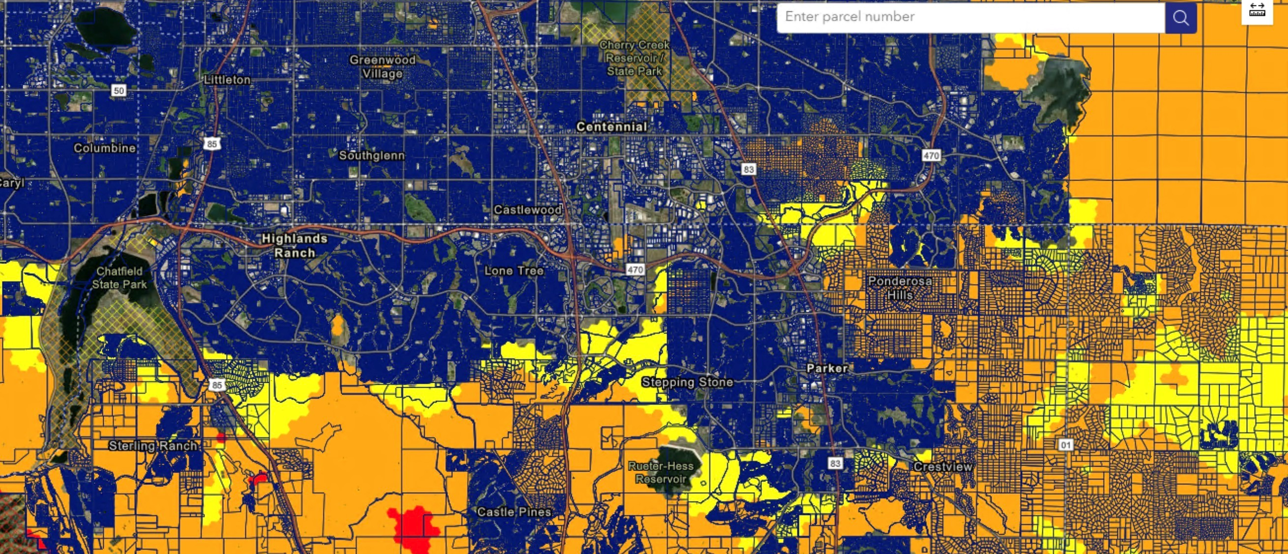
The Map: Link Here
Notes:
The zones tell us how strong the wildfire threat is and how strong the home’s protection must be.

Slide 6
The Map Explained
🟡 Yellow (Low Intensity): Lower fire behavior; embers still a risk.
Requires Class 1 protections (Class A roof, metal gutters, ember-resistant vents)
🟠 Orange (Moderate Intensity): Stronger fire behavior with more fuels.
Requires Full Class 2 protections.
🔴 Red (High Intensity): Highest fire behavior, long flame lengths potential, fast spread.
Requires Full Class 2 protections + strongest defensible space

Slide 7
What Changes for the Community?
Not as much as some may think.
Many things are already being addressed under current building, energy, and planning codes.
  Class A fire-rated roofing materials
  Ember-resistant attic and foundation vents
  Multi-pane windows to help protect radiant transfer
  Ignition-resistant siding and exterior materials
  Reducing combustible materials in the first 0–5 feet around structures.

Slide 8
Colorado CWRC Adoption Timeline
State adopts the Colorado Wildfire Resiliency Code
April 1, 2026 – Local governments required to adopt the code or equivalent
July 1, 2026 – Jurisdictions expected to be implementing the adopted code
Applies to mapped Wildland Urban Interface areas
Local jurisdictions maintain authority for adoption and enforcement and local ground truthing.

Slide 9
Ground Truthing
Process through which property can be locally verified and either added to or removed from WUI (regardless of map).
Can occur at the parcel level or development level.
Must be based on principles used to create the map (density, topography, vegetation, historic weather and fire data).
Some of our jurisdictions may seek SMFR expertise in evaluating technical reports for ground truthing.

Slide 10
Jurisdiction CWRC Status
Adopting the State Code and Map
  City of Centennial
  Town of Parker
  City of Lone Tree
  Arapahoe County
  Douglas County (possible IGA)
  City of Castle Pines
  Town of Foxfield
  SMFR (Title 32 Limits Enforcement)
Alternative Approaches
  Jefferson County – adopting a more stringent code created with FD input and public comment – resolution to follow.
  City of Littleton – already adopted the IWUIC (may need state approval).
  City of Cherry Hills Village – still evaluating options.
  City of Greenwood Village – evaluated options and chose not to adopt.
  Other AHJs – No WUI on state map, so no adoption needed.

Slide 11

Questions

