Slide 1
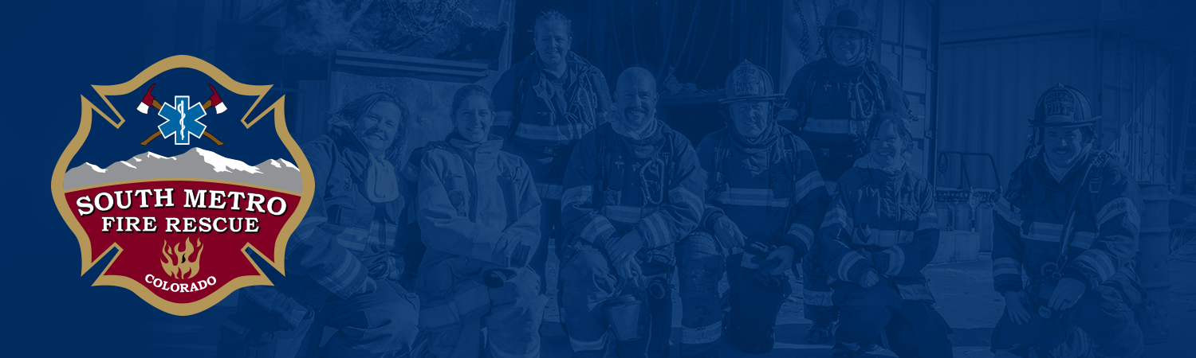

South Metro Fire Rescue
Training Facilities Overview
September 28, 2026

Slide 2
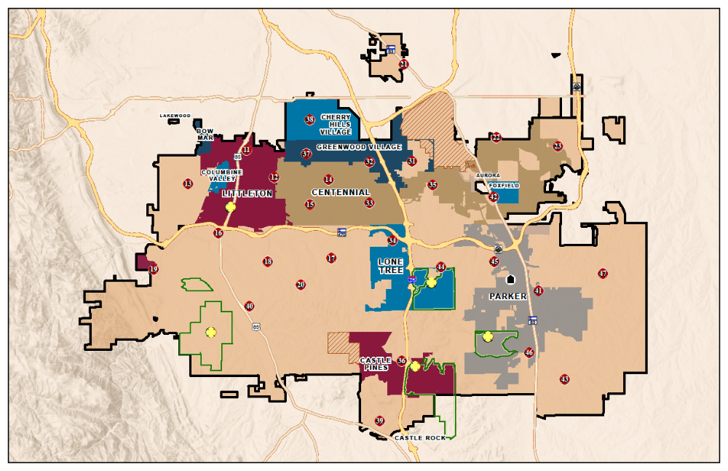
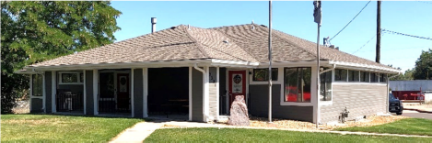
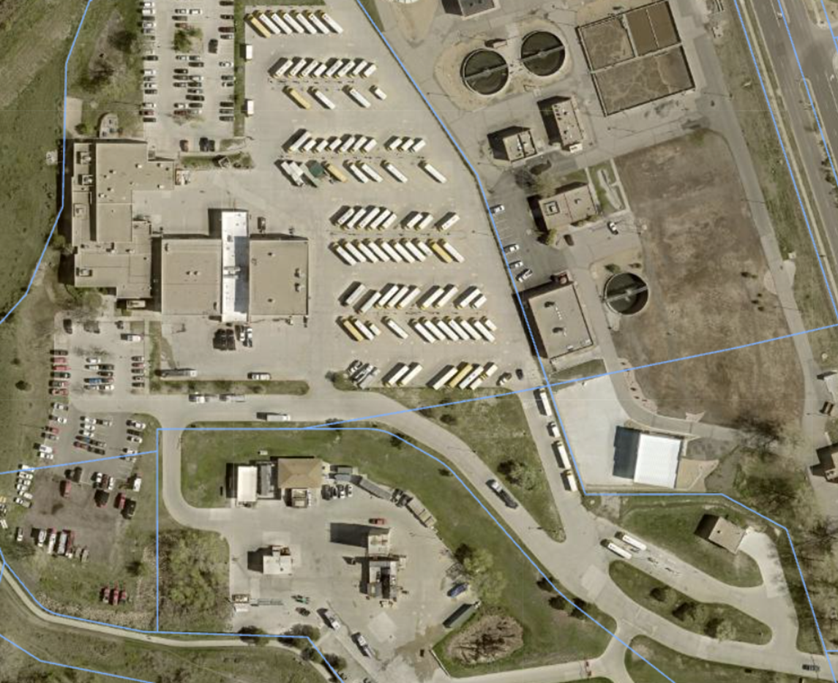
Training Facilities
History and background
  JSF - Training
  TJ Training Center
Strategy – 10-year plan
Future needs and vision

Slide 3
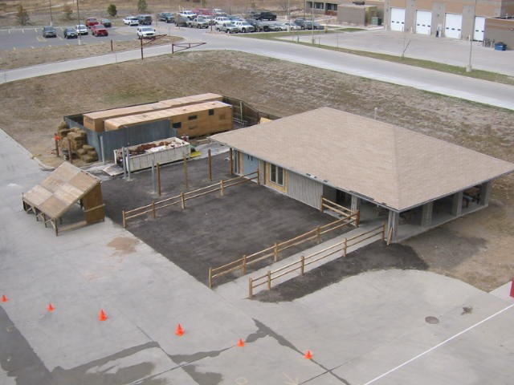

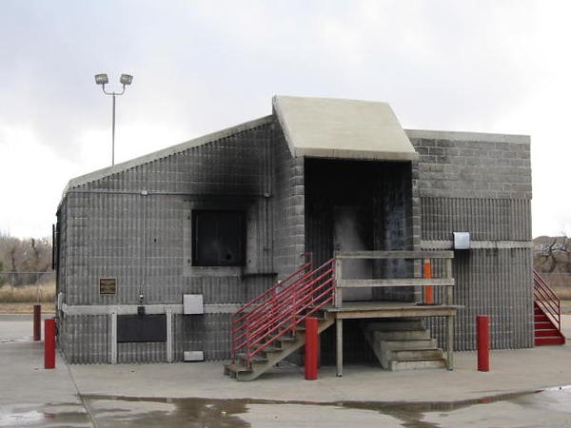


JSF - Training
Background
  Built in 1993
  48,000 SF
Current Limitations
  Training props – lack realism and adjustable configuration
  Clean areas and decontamination areas for firefighter safety and wellness
  Lack of storage for equipment and apparatus
  Lack adequate classrooms and office space – RTOs in temporary trailer
  Flood plain and joint ownership
Notes:
No multi-family
Rental trailer

Slide 4
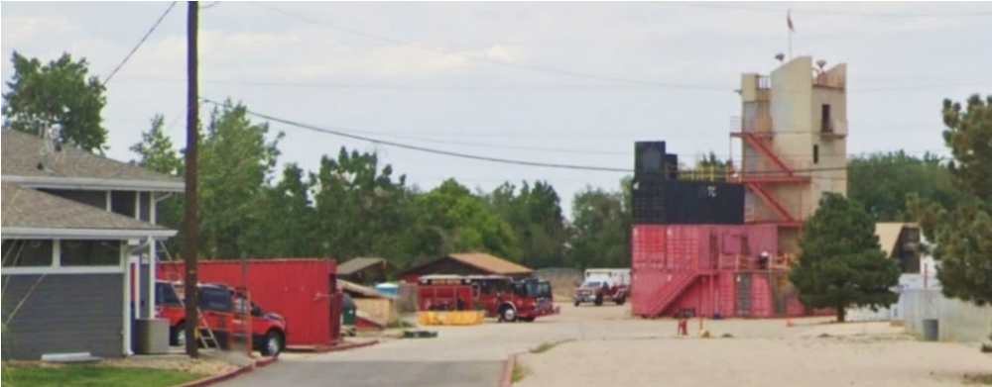
TJ Training Center
Background
  Built in 1982
  5,220 SF plus props and drill ground
Limitations
  Realistic training props – adjustable configuration
  Clean areas and decontamination areas for firefighter safety and wellness
  Lack of storage for equipment and apparatus
  Lack adequate classrooms and office space
  Subject to Environmental use Restrictions
  Located in Englewood on the edge of the district

Slide 5
Strategy – November of 2024
Review recommendations from Abercrombie Report
Determination that centrally locating new training facility would be very challenging in our district – land cost, permitting, airport concerns, cost of construction.
Explore options for fleet relocation/expansion. These conversations also included training.
Training center upgrades at TJ and JSF to meet current and future needs. Re-vision without fleet at JSF.
Communicated during the 2024 budget workshops and capital added to the 10-year plan and 2025 budget.
Notes:
Hand out one-page Abercrombie Report.
Permitting concerns for new training center – live fire, neighbors' environmental impact.

Slide 6
Current 10-year plan - $60 million budget
 | 2026 | 2027 | 2028 | 2029 | 2030 | 2031 | 2032 | 2033 | 2034
Training Facilities |  |  |  | 5,000,000 | 5,000,000 | 5,000,000 | 5,000,000 | 5,000,000 | 5,000,000
Phase 1: Fleet Center New Build | 10,000,000 | 10,000,000
Phase 2: Logs Relocation |  |  | 10,000,000

Slide 7
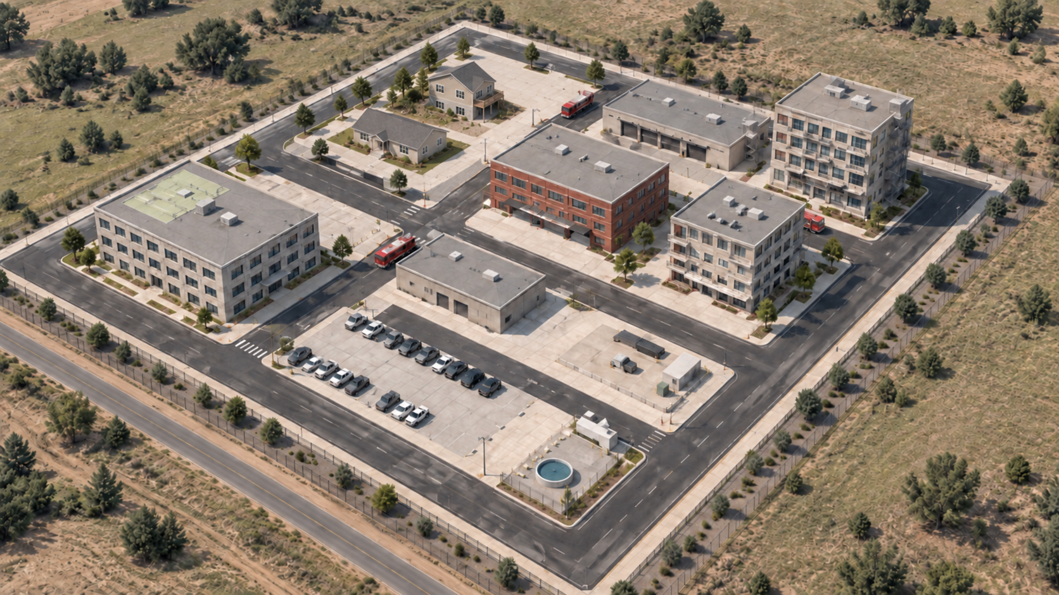
Training Vision and Needs
JSF – Recruit Academies
Alternative Site – Incumbents
2
6
4
1
Training package | Site | #
Infrastructure / streets | JSF & Alternative Site | 0
Five-story tower / mid-rise | JSF & Alternative Site | 1
Walk-out live-fire (clean) | Alternative Site | 2
Multifamily training shell | JSF & Alternative site | 3
Ranch live-fire | JSF | 4
Mainstreet live-fire (clean) | Future | 5
Indoor training hall | JSF | 6
Staff & learning center | JSF | 7
Decon & readiness | JSF & Alternative Site | 8
Special Teams | JSF | 9
EV / future training | Alternative Site | 10
5
7
3
8
9
10
Notes:
The concept places the five-story DTC mid-rise at the back right, the ranch and walkout residential training block at back left, Parker Mainstreet at center, and the multifamily shell at center right. The roads and convertible parking court serve low-speed driver/operator training as well as everyday access. The complete program also includes the indoor drill hall, learning center, decon and rescue/utility training spaces.
The long-term operating split is JSF for recruit training and the new campus for incumbent training. Any live-fire areas would use Class B gas systems. The tower and multifamily shell are dry-training concepts.

Slide 8
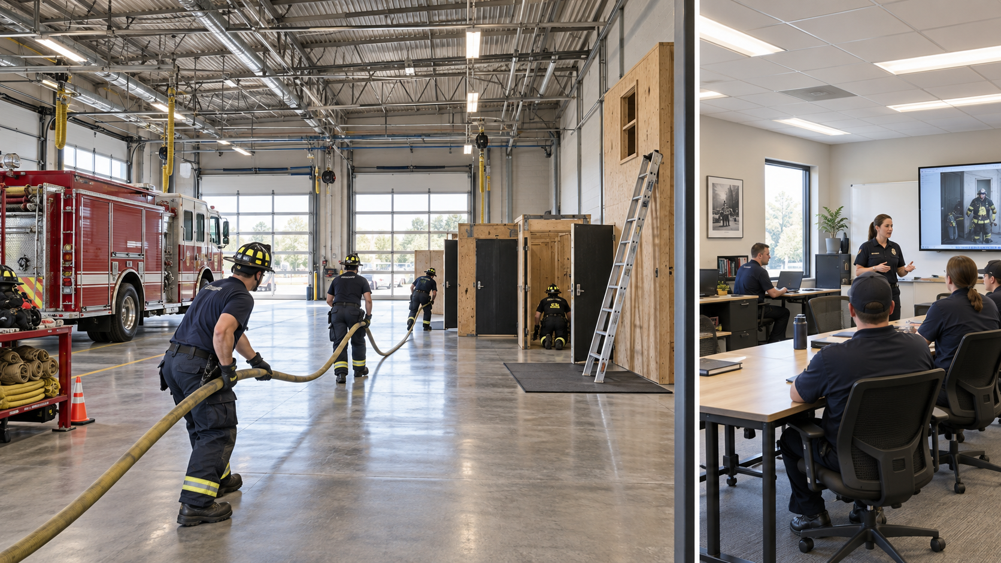
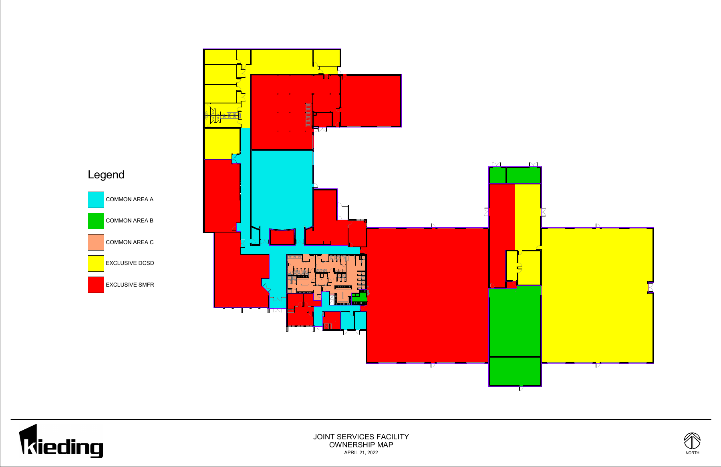
JSF – Interior
Fleet /Logistics add access:
  Staff and Learning Hall
  Indoor Training Hall
  Decon / Lockers
1
2
Yellow and green excluded. Office view is illustrative.
Notes:
The original building ownership map remains the location reference. Callout 1 identifies the large red Fleet bay area. Callout 2 identifies the red offices below the pink common area and next to the blue area. Those offices would support Learning and Development, including staff work and instruction preparation. Once the new Fleet/Logistics facility opens, available indoor classrooms and showers there can also support training. That shared support bridges the period until the Phase 3 staff and learning center opens. JSF keeps its recruit learning spaces
Yellow and green remain outside this reuse plan. Blue and pink remain shared spaces; this plan assumes no exclusive control of them. We can improve what is available within our existing SMFR areas as Fleet relocates.

Slide 9
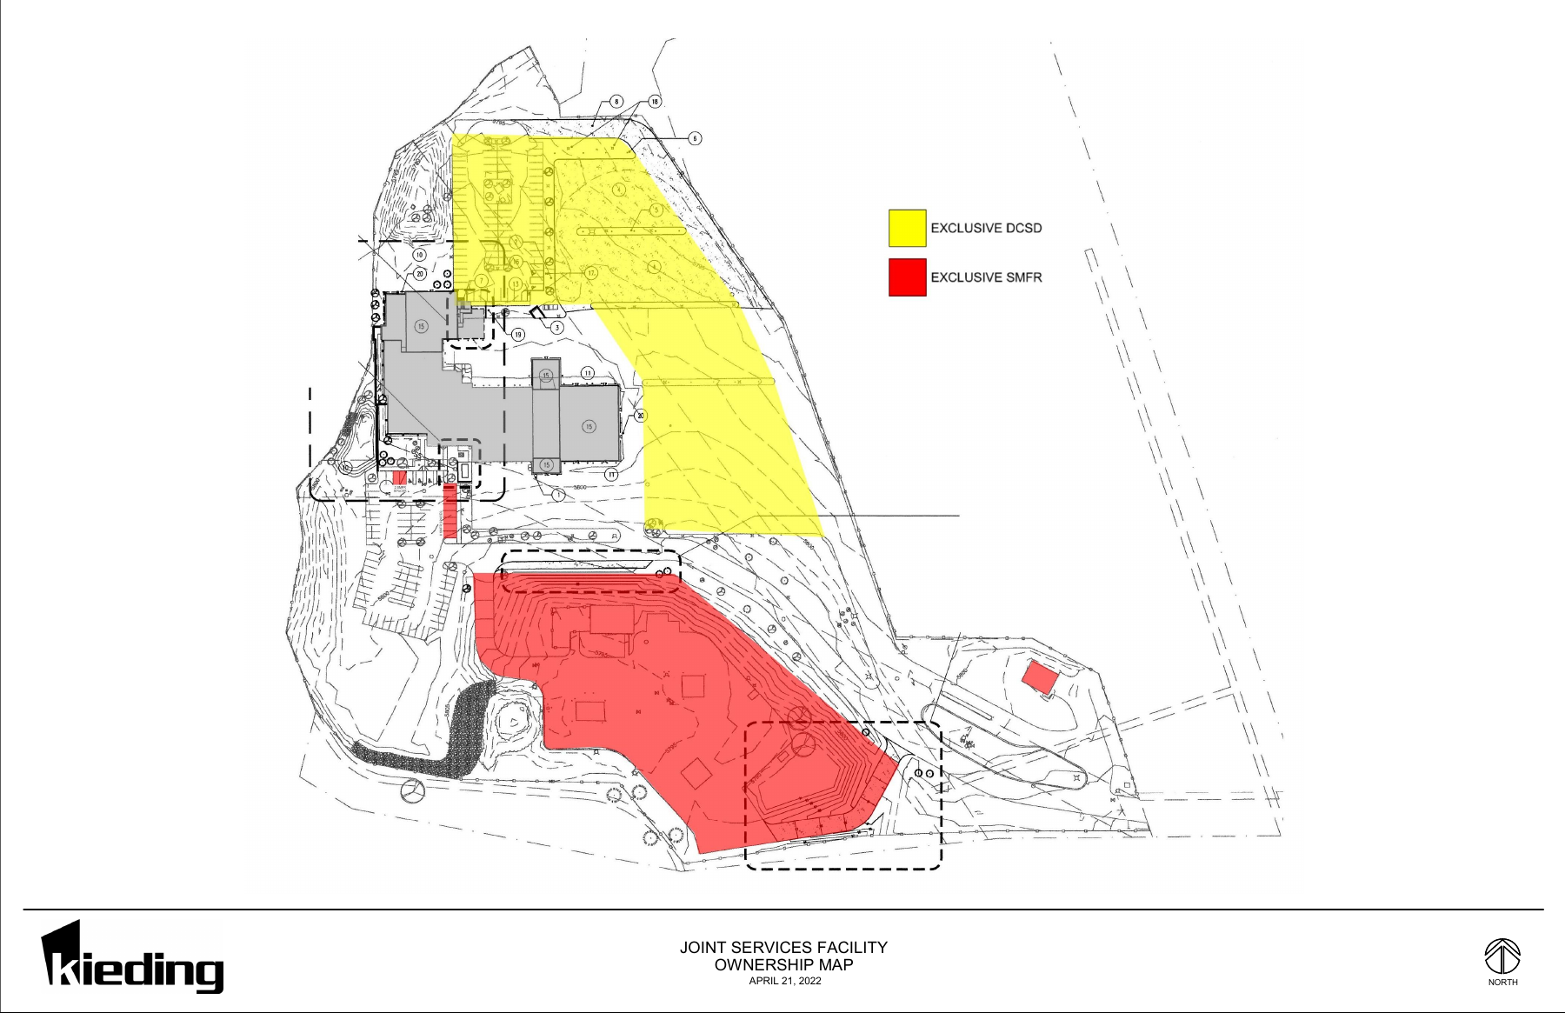
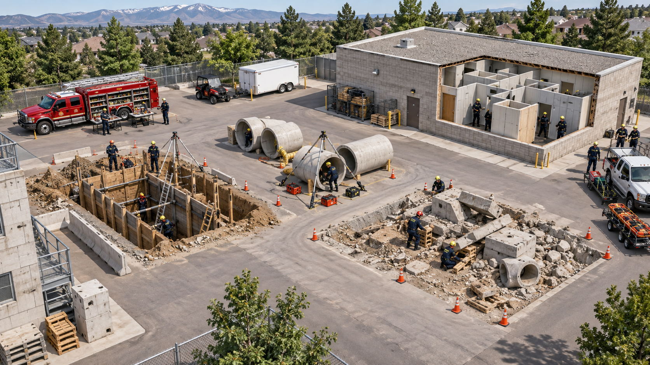
JSF – Exterior / Drillground
Tower
Multi-Family training shell
Ranch Live Fire
Special Team
EV /Future Training
Notes:
We would use the available drillground for Special Operations and continue evaluating the layout. The large rendering shows examples already represented in the interactive campus program: engineered trench props, confined-space pipe props, collapse and vehicle stabilization, and a modular maze. The end-of-property building would be evaluated for confined-space and maze training. Its location on the actual ownership map is the small separate SMFR building at the far right.

Slide 10
Next steps
  Continue efforts to move fleet out of the JSF facility
  Upgrade JSF to meet the needs of district training and year-round recruit academies
  Infrastructure upgrades at the JSF aligned with future vision
    Burn can
    Ventilation prop
    Electrical transformer
    Hydrants
    Class A burn building repairs
  Continue evaluation of TJTC
    Burn can
    Training tower
    Alternative sites
Notes:
DCSO EVOC training site – shared facility

Slide 11
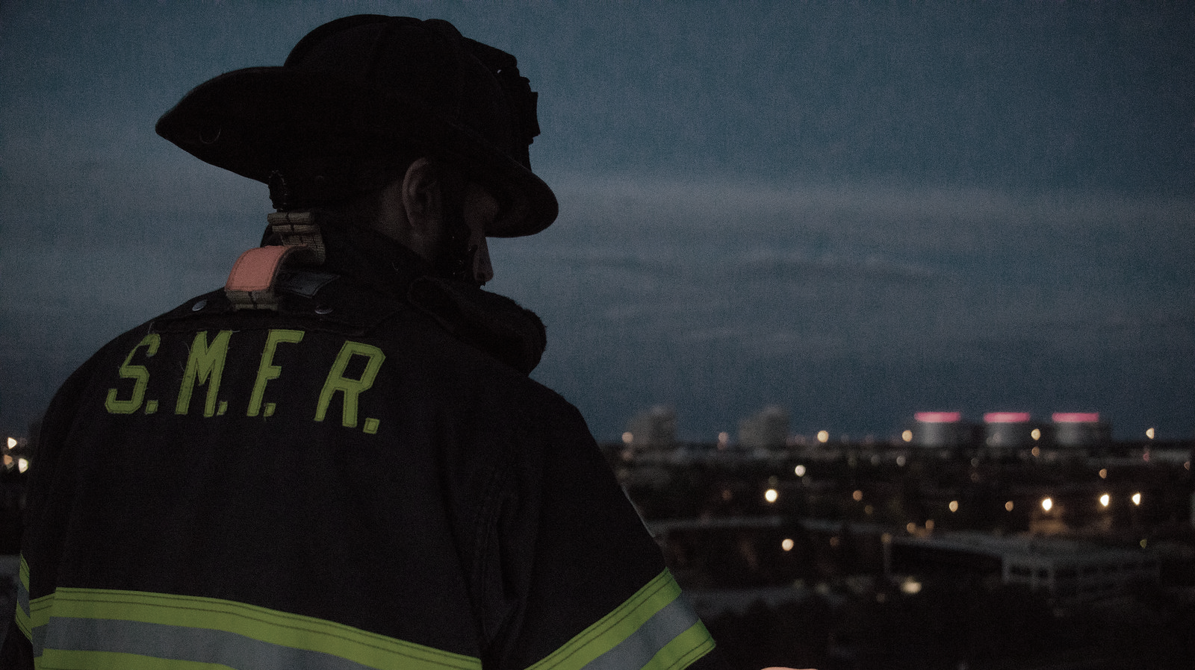

Questions?

